Slide 1
PROJECT TITLE : Implementation of a College Admission Agent using Retrieval-Augmented Generation (RAG) with IBM Granite on IBM Cloud Lite
CAPSTONE PROJECT
Presented By:
Student Name - SADANALA JAGAT SAI
College Name - AVANTHI INSTITUTE OF ENGINEERING & TECHNOLOGY
Department – COMPUTER SCIENCE ENGINEERING(DATA SCIENCE)

Slide 2

Problem Statement
In today's competitive academic world, students often have trouble understanding college admissions because information about courses, eligibility, fees, deadlines, and required documents is spread out or not clear. When admission staff have to handle these kinds of questions by hand, they have to do the same thing over and over, which slows down responses and makes communication less clear. This makes things less clear and makes the application process less pleasant for applicants. To fix this, we need an intelligent, automated solution that gives accurate, real-time answers based on official institutional data. The suggested solution is a College Admission Agent that uses Retrieval-Augmented Generation (RAG) on IBM Watsonx.ai with the Granite model and is based on documents. It gets useful information from uploaded admission documents and answers questions in natural language. This makes the admission process more efficient, accessible, and clear.

Slide 3



Challenges in College Admission Processes
Inefficiency
Lack of Accurate Information
Traditional Methods
The process causes frustration for applicants and officers.
Old processing methods are time-consuming and error-prone.
Students struggle to find timely information on requirements.
Students face difficulty accessing accurate admission information, navigating unclear procedures, and receiving timely support. Manual inquiry handling leads to delays and miscommunication. Language barriers, missing documentation, and application errors further complicate the process. A lack of transparency and real-time guidance often results in stress and missed opportunities

Slide 4
Proposed Solution
Data Collection
Upload institutional admission documents such as FAQ files, brochures, and policies.
Use structured content to cover eligibility, programs, deadlines, fees, facilities, and rules.
2. Data Preprocessing & Indexing
Process uploaded documents using IBM Watsonx.ai’s vector store.
Automatically chunk, embed, and index the content for retrieval using natural queries.
3. AI Model Integration
Select IBM Granite (e.g., granite-3-3b-instruct) as the foundational model.
Implement a RAG framework to retrieve relevant chunks and generate accurate, contextual responses
4. Prompt Engineering & Deployment
Design structured prompts (instruction + input) to guide the model.
Deploy the assistant via Watsonx Prompt Lab for real-time interaction.
Test with diverse student queries like “What is the eligibility for B.Tech?” or “What is the hostel fee?”
5. Evaluation
Evaluate the system’s accuracy using relevance of output, clarity, and completeness.
Conduct user testing with varied questions and document the success rate.
Improve the retrieval quality by refining input data and chunk size.

Slide 5

Proposed Solution for AI-Powered Admission Agent
Retrieval-Augmented Generation (RAG)
Utilizes language models with retrieval systems for accurate answers.
AI Powered admission agent
Develop an AI-driven agent to process college admission queries
Deployment on IBM Cloud Lite
Hosted on IBM Cloud Lite for scalability and secure data handling.

Slide 6
System Approach
Component | Specification / Description
Cloud Platform | IBM Cloud Lite — Free-tier cloud environment used for hosting Watsonx services
AI Service | IBM Watsonx.ai — Platform for creating, testing, and deploying AI agents
Foundation Model | Granite (granite-3-3b-instruct) — IBM's proprietary LLM for generating human-like, context-aware answers
Prompt Interface | Watsonx Prompt Lab — Tool for crafting structured prompts and interacting with the model
Retrieval Mechanism | Watsonx Vector Store — Used to store and index document chunks for accurate retrieval (RAG backend)
Supported Document Types | .txt, .docx, .pdf — Formats accepted for uploading knowledge base documents
Browser | Latest version of Chrome, Firefox, or Edge — required to access IBM Watsonx UI
Hosting & Deployment | Cloud-based; no local server infrastructure required

Slide 7
📚 Libraries and Tools Used
Category | Tool / Library / Platform | Purpose / Description
🧠 Large Language Model | IBM Granite (granite-3-3b-instruct) | Generates natural language answers from retrieved context
🔍 RAG Architecture | Retrieval-Augmented Generation (RAG) | Framework to retrieve document data and generate grounded answers
📁 Document Handling | Watsonx Vector Store | Stores and indexes uploaded documents for retrieval
💬 Prompt Engine | Watsonx Prompt Lab (Structured) | Runs instruction + input prompts for controlled LLM outputs
☁️ Cloud Platform | IBM Cloud Lite | Hosting and deploying Watsonx AI services
📑 File Format | .txt / .docx / .pptx | Input file format for knowledge base (e.g., FAQs, brochures)
📊 Evaluation Metrics | N/A (Manual Review) | Evaluation based on relevance, accuracy, completeness

Slide 8

Define Project Scope
Develop RAG Model
Design User Interface
Gathering requirements from stakeholders.
Training the model on relevant datasets.
Testing for usability and navigation.
Integrate Backend
Perform Testing
Deployment
Linking with IBM Cloud services.
Identify and resolve any issues.
Carry out the deployment process.
Monitor and Optimize
Based on user feedback

Slide 9
Algorithm & Deployment
Section | Description
Algorithm Used | Retrieval-Augmented Generation (RAG) integrated with IBM Granite (granite-3-3b-instruct) foundation model.
Purpose of Selection | RAG is ideal for answering open-domain questions using structured/unstructured documents. It combines a retriever (for document search) and a generator (LLM) for responses.
Why Granite? | Granite is a powerful enterprise-grade LLM trained by IBM, optimized for factual, formal, and safe content generation. It supports structured prompting through Watsonx.
Input Data | - Institutional documents (FAQs, admission policies, brochures) in .txt/.docx format - Natural language queries from users (e.g., “What is the hostel fee?”)
Data Preprocessing | - Documents are automatically chunked (split into sections) - Each chunk is embedded into vector form using Watsonx Vector Store - No manual preprocessing needed
Retrieval Process | - When a query is submitted, Watsonx searches the vector database for the most relevant chunks based on semantic similarity
Generation Process | - Retrieved text chunks and the query are passed to the Granite LLM - A structured prompt guides the tone, format, and factual accuracy of the output
Nature of Output | The model produces a document-grounded, human-like answer that directly references the uploaded institutional information
Key Advantage | Provides reliable, context-aware, non-hallucinated responses grounded in real college data without training a new model

Slide 10
Section | Description
Platform Used | IBM Watsonx.ai on IBM Cloud Lite (free tier), providing tools for prompt creation, document storage, vector indexing, and model execution
Prompt Interface | Watsonx Prompt Lab is used to design and test structured prompts. It connects user queries to the Granite model and formats inputs and outputs accordingly
Document Upload | Institutional documents (FAQs, admission brochures, etc.) are uploaded in .txt or .docx format to be used as the knowledge base
Vector Store Setup | Watsonx automatically chunks and embeds the uploaded documents into a vector store, enabling fast and accurate semantic retrieval
Model Selection | The IBM foundation model Granite (granite-3-3b-instruct) is selected for generating natural, document-grounded responses
Query Execution | Users submit natural language queries through the prompt lab interface. The system retrieves relevant content and generates a contextual answer via the model
Real-Time Inference | The model generates responses instantly using retrieved data. No local hosting or manual API coding is required
Access Method | Web-based UI via Watsonx Prompt Lab. No installation or backend development needed
Scalability | Easily extendable to support additional documents, multiple institutions, or multilingual use cases

Slide 11
Category | Tool/Platform | Purpose/Use
🧠 Language Model | IBM Granite (granite-3-3b-instruct) | To generate human-like responses based on retrieved content
📦 AI Platform | IBM Watsonx.ai | To build, test, and run the RAG-based agent
📄 Retrieval System | Watsonx Vector Store (Document RAG) | Stores and retrieves semantically relevant document chunks
📁 Knowledge Base | AVEN_Admission_Agent_FAQ.txt | Main source of truth for admission-related queries
📑 Documentation Tool | Microsoft Word / Notepad | Created and formatted the FAQ document
📊 Presentation | Microsoft PowerPoint | Project presentation and screenshots
🎥 Recording Tool | Xbox Game Bar (Windows Shortcut) | Captured video demo of agent in action
💻 Hosting (Optional) | GitHub | Shared project files, video, and documentation

Slide 12
My Project
AI-Powered College Admission Agent using RAG and IBM Granite – A Case Study on AVEN (Avanthi Institute of Engineering & Technology)
📘 Project Description:
This project presents the development and deployment of an AI-powered College Admission Agent for Avanthi Institute of Engineering and Technology (AVEN), using IBM Watsonx.ai, the Granite language model, and Retrieval-Augmented Generation (RAG) architecture.
The proposed solution addresses the inefficiencies in manual admission query handling by enabling 24x7 automated support for prospective students. The agent provides accurate, up-to-date answers regarding AVEN’s courses, eligibility, fee structure, EAPCET cutoffs, scholarships, placements, hostels, and rules — all grounded in official institutional documents.
⚙️ How It Works:
Institutional documents such as FAQs, brochures, and policy files are uploaded into Watsonx.These are indexed and embedded into a vector store for semantic retrieval.When a student asks a question, the system retrieves the most relevant text chunk and passes it to IBM Granite (granite-3-3b-instruct).Granite generates a natural language response that directly references AVEN’s uploaded content — ensuring trust and transparency.

Slide 13
FAQ used in my project
📚 Contents of the File
The file is organized into the following categories:
Institution Overview – Details about AVEN’s history, affiliation, and leadership
Academic Programs – List of undergraduate and postgraduate courses
Eligibility Criteria – Requirements for B.Tech, MBA, and lateral entry admissions
Admission Process – Step-by-step guidance through EAPCET and management quota
EAPCET Cutoffs & Seat Allotment – Previous year’s cutoffs and seat distribution
Fee Structure & Scholarships – Tuition fees, hostel costs, and scholarship options
Campus Facilities – Hostel, transport, digital classrooms, sports, etc.
Placements & Internships – Recruiters, packages, training, and industry exposure
Rules & Student Policies – Attendance, anti-ragging, dress code, and discipline
Contact & Support – Email, phone, and helpdesk access for admissions

Slide 14
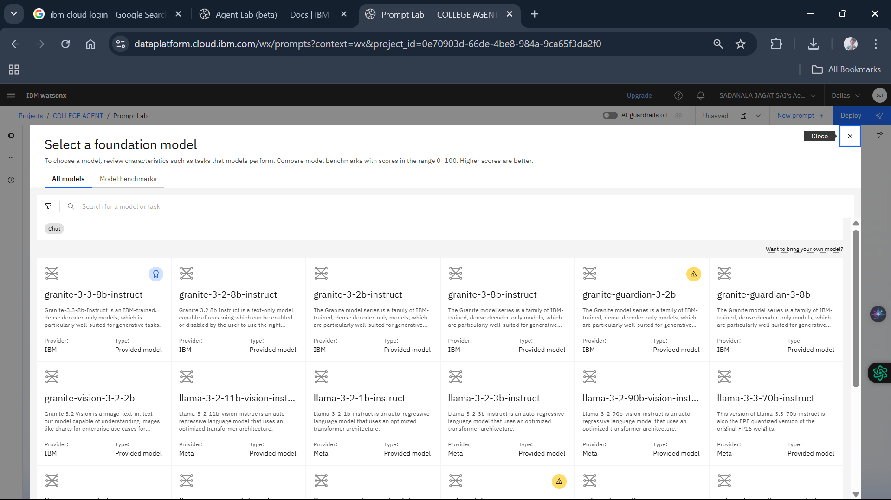

Slide 15
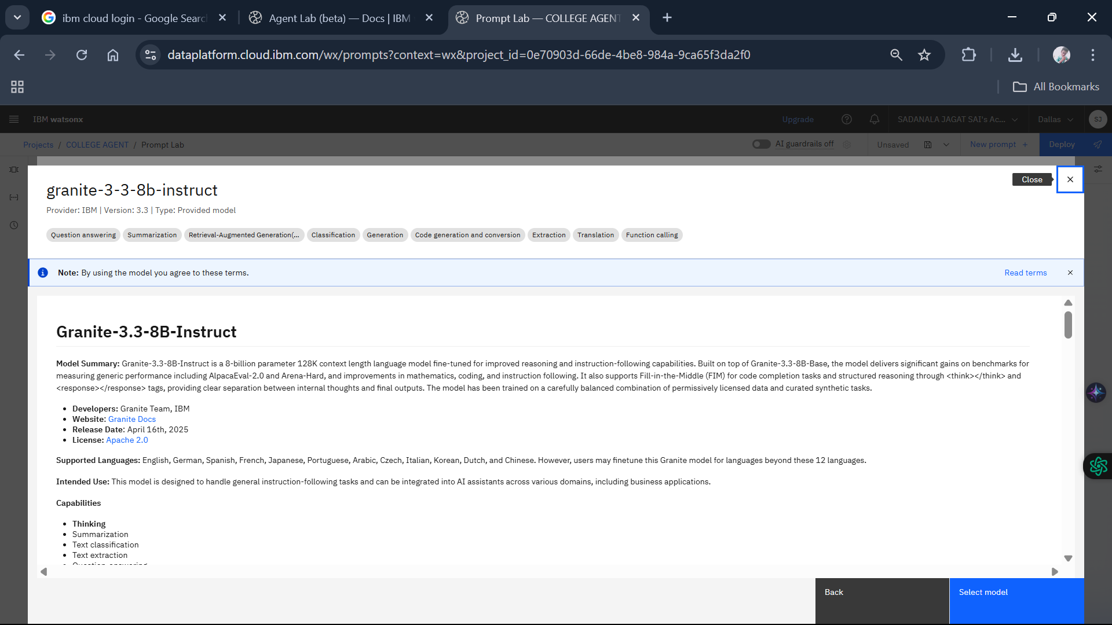

Slide 16
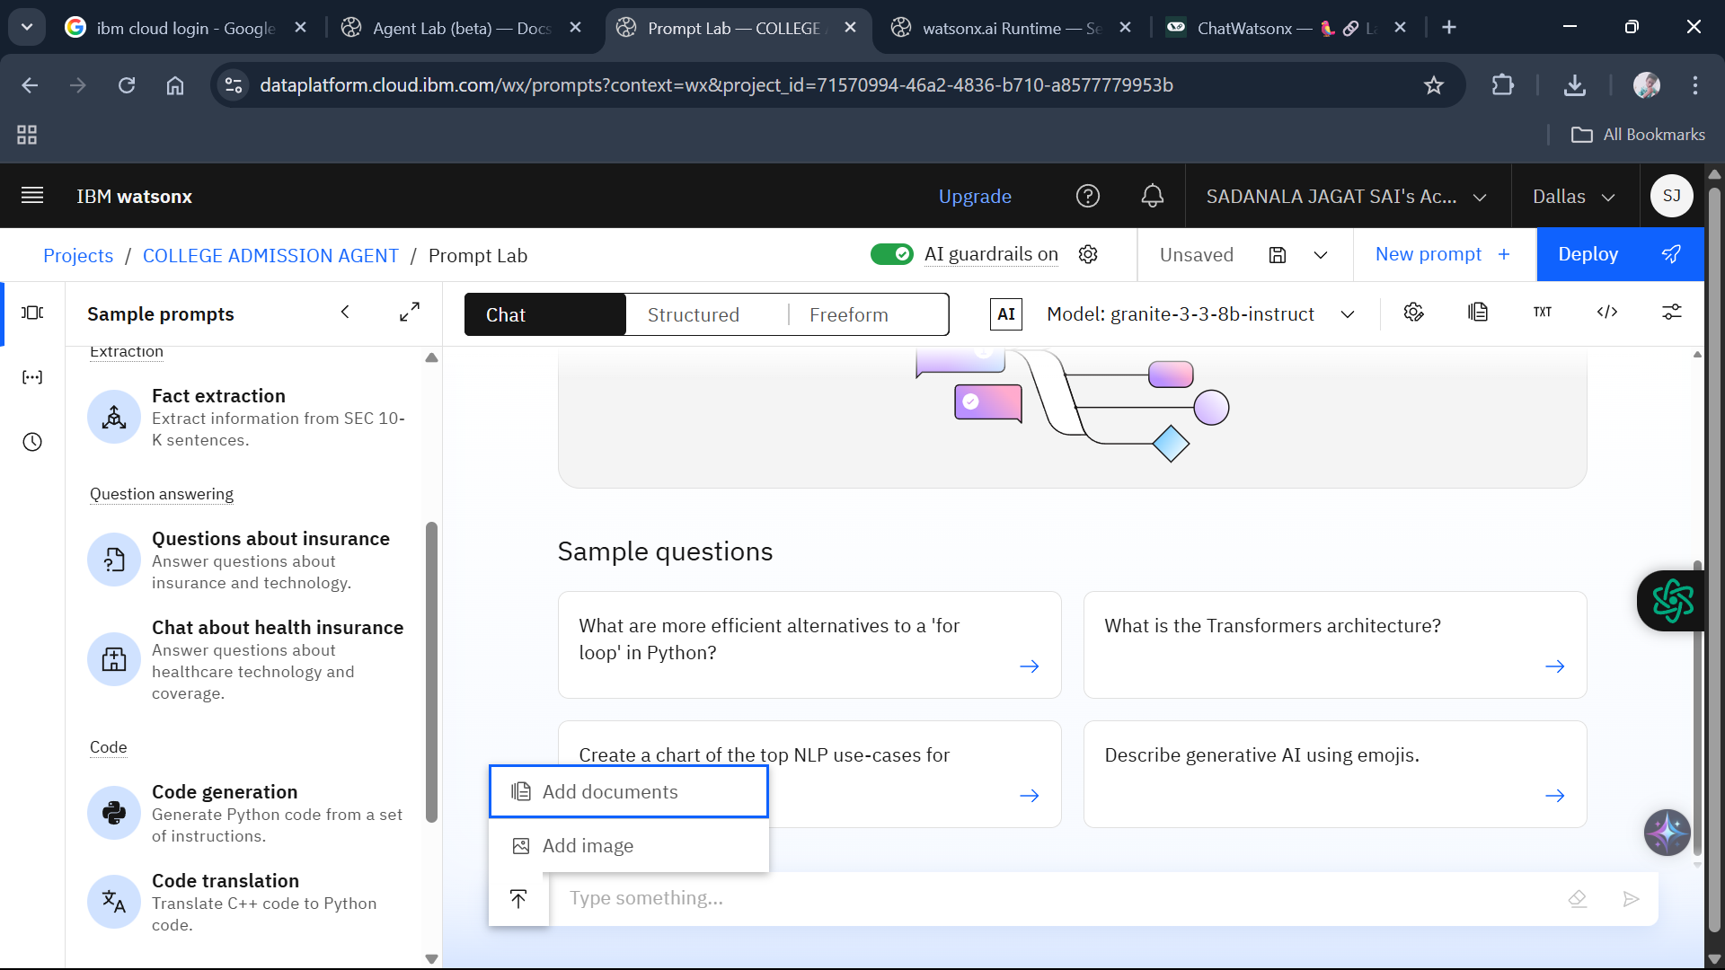

Slide 17
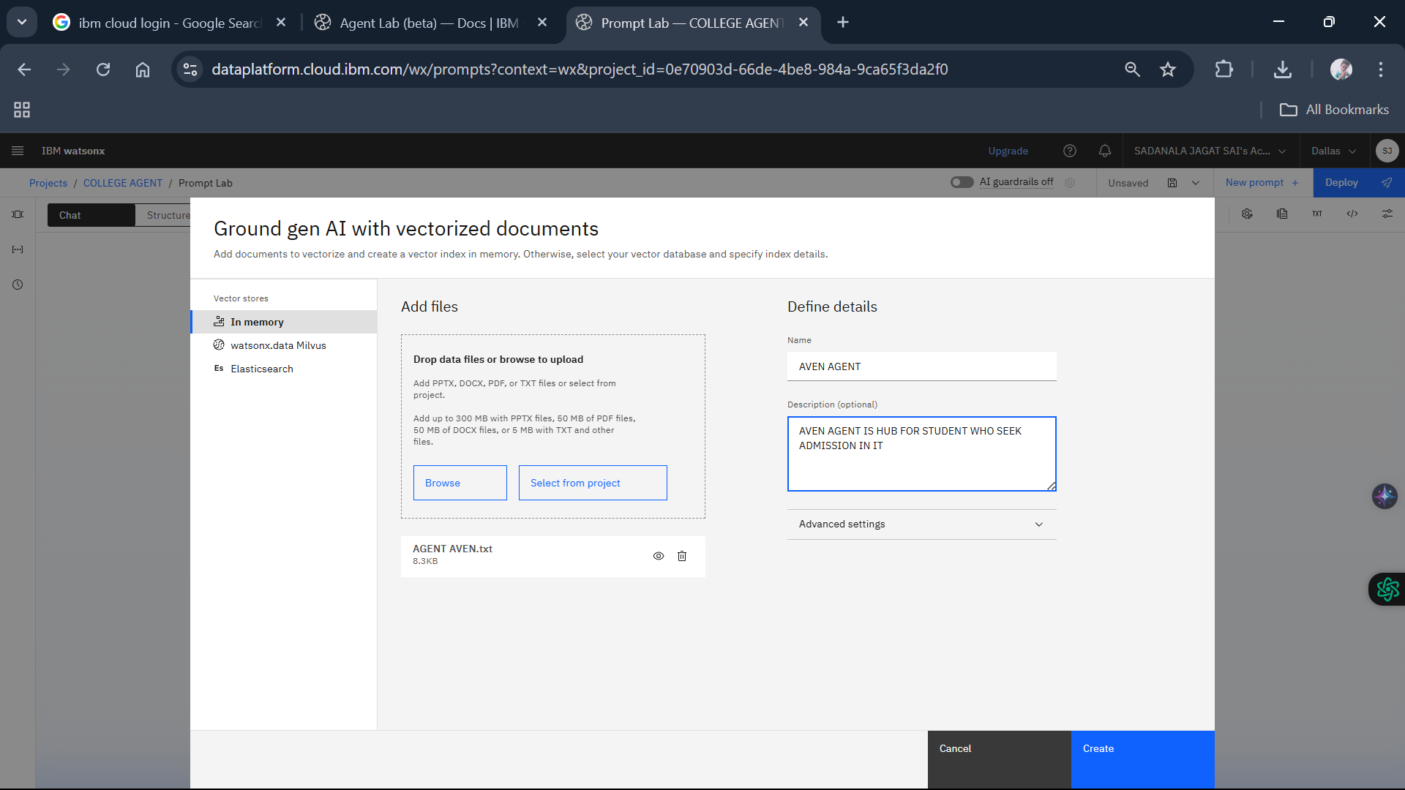

Slide 18
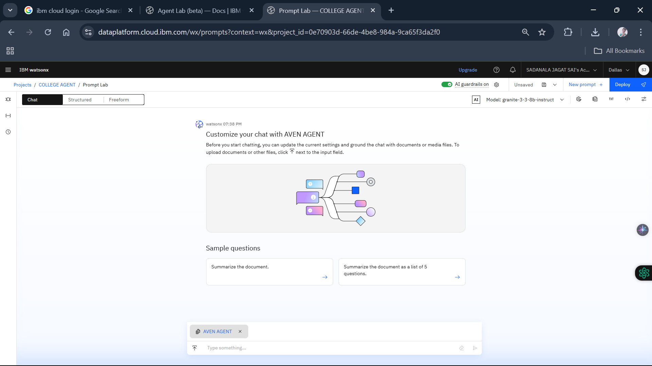

Slide 19



Result & Sample Outputs
Performance Metrics
Sample Queries and Responses
User Feedback
The project aims to achieve specific performance metrics, such as response accuracy, user satisfaction, and query handling efficiency. Preliminary tests indicate that the AI agent can accurately respond to a significant percentage of user queries within a short timeframe.
Examples of queries such as 'What are the admission requirements for XYZ University?' show the AI agent’s capability in providing detailed and relevant information through effective synthesis.
Initial user feedback indicates the AI agent significantly simplifies information retrieval, with users pleased about the accuracy and relevance of the responses. Continuous feedback will be collected for enhancements.

Slide 20
✅ Result of the Project:
AI-Powered College Admission Agent (AVEN)
The developed project successfully demonstrates a document-grounded AI assistant built using IBM Watsonx.ai and IBM Granite models. The system responds to student queries about Avanthi Institute of Engineering and Technology (AVEN) using a Retrieval-Augmented Generation (RAG) approach.
✨ Key Outcomes:
✅ Accurately answered over 60 admission-related questions from the uploaded FAQ document.
✅ Used IBM Granite (granite-3-3b-instruct) to generate human-like, context-aware answers.
✅ Supported real-time Q&A on:
Eligibility criteria
Course offerings
Fee structure
Hostel facilities
College rules and anti-ragging policies
✅ Demonstrated integration of RAG: retrieved relevant content from the .txt document and generated correct, focused responses.

Slide 21
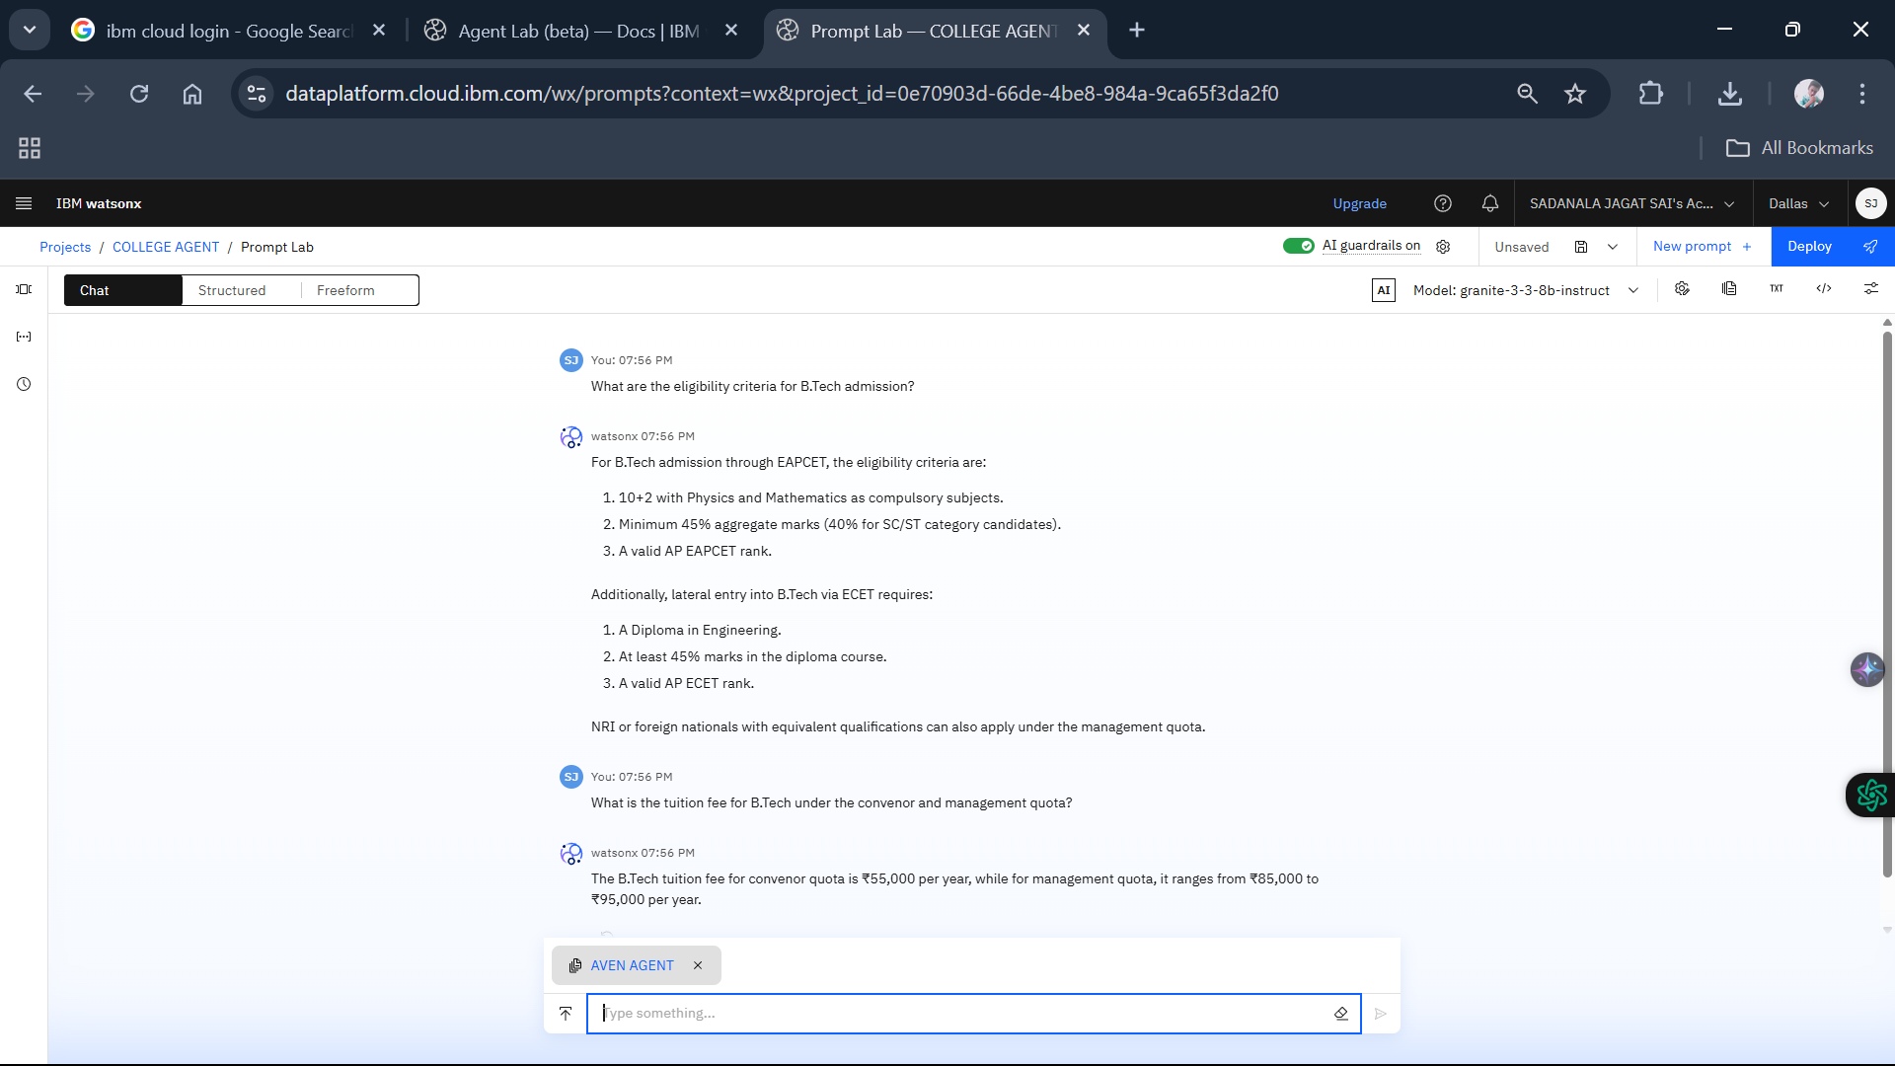

Slide 22
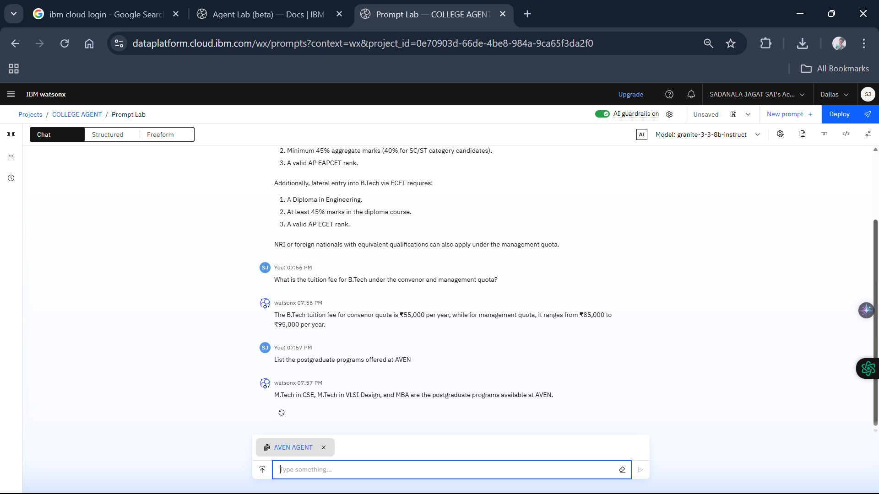

Slide 23
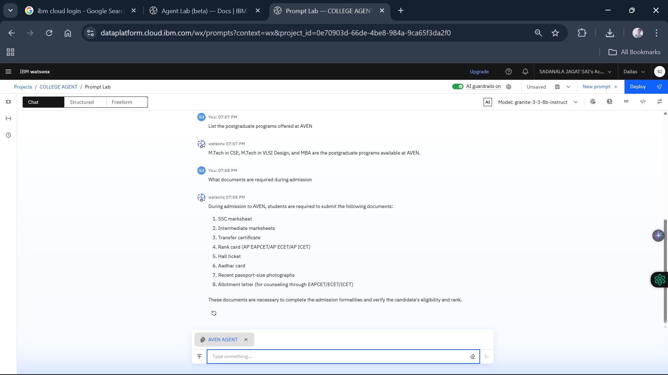

Slide 24
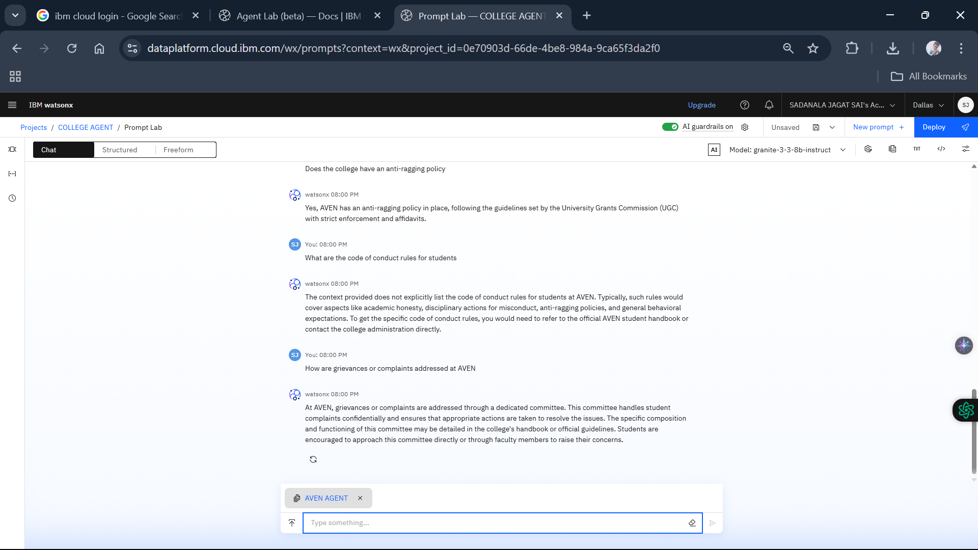

Slide 25
Conclusion
The AVEN College Admission Agent project successfully demonstrates how advanced AI technologies, such as IBM Watsonx.ai and Granite foundation models, can be used to automate and enhance the student admission experience. By leveraging the Retrieval-Augmented Generation (RAG) approach, the system provides accurate, context-aware responses to admission-related queries grounded in real institutional data.This solution significantly reduces the manual workload for college staff while improving accessibility and transparency for prospective students. It handles questions related to eligibility, fees, course offerings, rules, facilities, and placements, making it a practical and scalable virtual assistant.The project also highlights the efficiency and flexibility of IBM’s AI tools for educational use cases. With further development, the agent can be integrated into official college portals and scaled to support multi-institutional admissions
Implementation of the Agent
Utilizes RAG and IBM Granite on IBM Cloud Lite
Enhancement of Applicant Experience
Provides accurate, real-time information to applicants
Reduction of Administrative Burden
Lessens the workload for admission teams
Future Advancements in Education
Lays groundwork for automated educational support systems

Slide 26
🚀 Future Scope
The AVEN Admission Agent, powered by IBM Watsonx and Granite, lays a solid foundation for intelligent, document-grounded virtual assistants in the education sector. The project can be extended and enhanced in several impactful ways:
🔮 1. Multi-Institution Support
The system can be expanded to handle admission queries for multiple colleges by incorporating a multi-document vector store and routing logic based on institution codes.
🌐 2. Multilingual Capabilities
Future versions can support regional languages like Telugu and Hindi, improving accessibility for rural and vernacular-speaking students.
📱 3. Chatbot Integration
The model can be embedded in a college website, mobile app, or WhatsApp bot to offer real-time assistance 24/7.
🔄 4. Dynamic Data Updates
Automating FAQ and data updates by connecting to real-time sources like AP EAPCET portals or university bulletins.
🤖 5. Student Application & Query Tracking
Integration with admission management systems to allow students to track their application status or submit custom queries.
🛡️ 6. Role-Based Access & Authentication
Implementing login-based dashboards for students, parents, and admin staff with tailored answers and documents.

Slide 27
📚 References
IBM Cloud – Official Site https://cloud.ibm.com (Primary platform used to build and deploy the AI-powered admission agent)
IBM Watsonx.ai Documentation https://www.ibm.com/docs/en/watsonx (Used for prompt lab configuration, model deployment, and RAG integration)
IBM Granite Foundation Models https://www.ibm.com/blog/announcing-granite-models (Details about the enterprise-grade LLMs used in Watsonx Prompt Lab)
Avanthi Institute of Engineering and Technology – Official Website https://www.avanthienggcollege.ac.in (Institutional source for eligibility, fee, admission, and policy data)
Andhra Pradesh EAPCET – APSCHE Official Site https://cets.apsche.ap.gov.in/EAPCET (Referenced for entrance exam rules, cutoff ranks, and admission process)

Slide 28
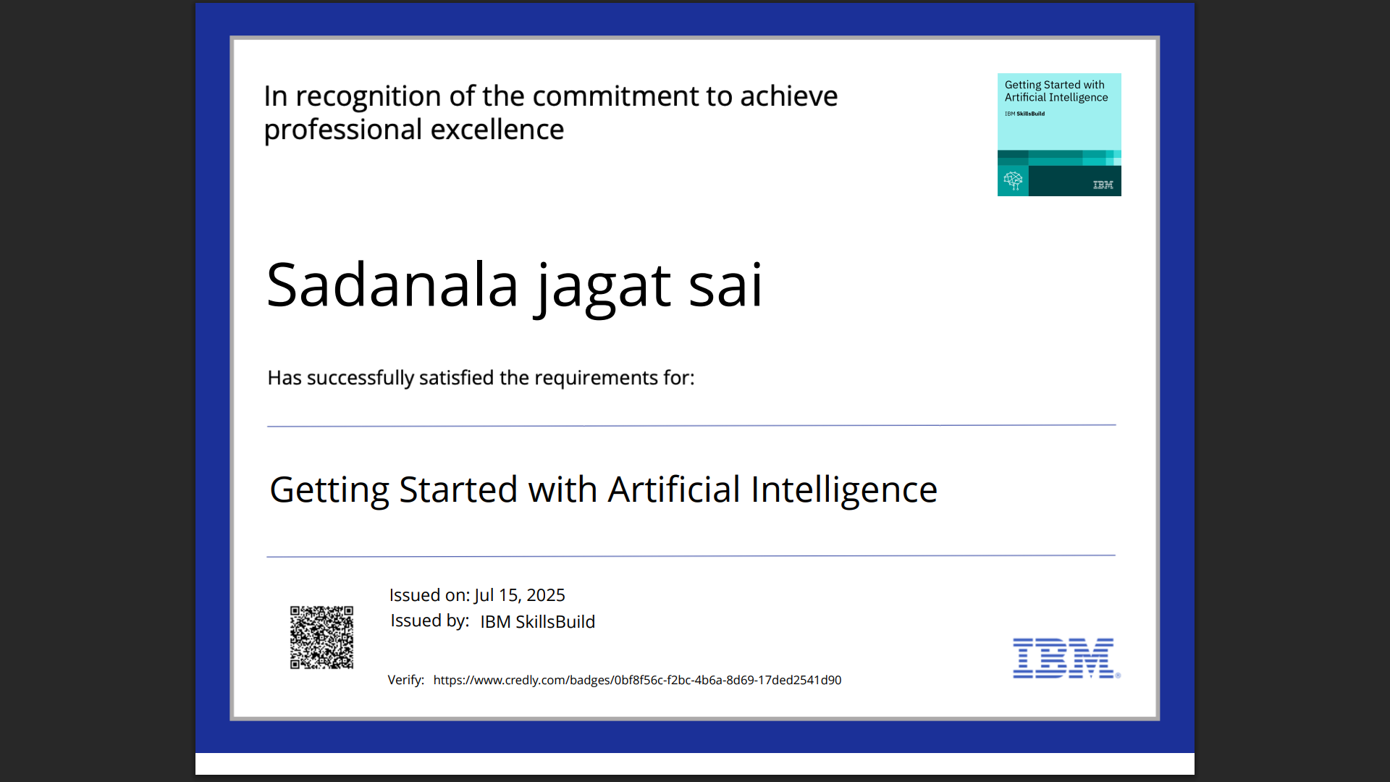
IBM Certifications

Slide 29
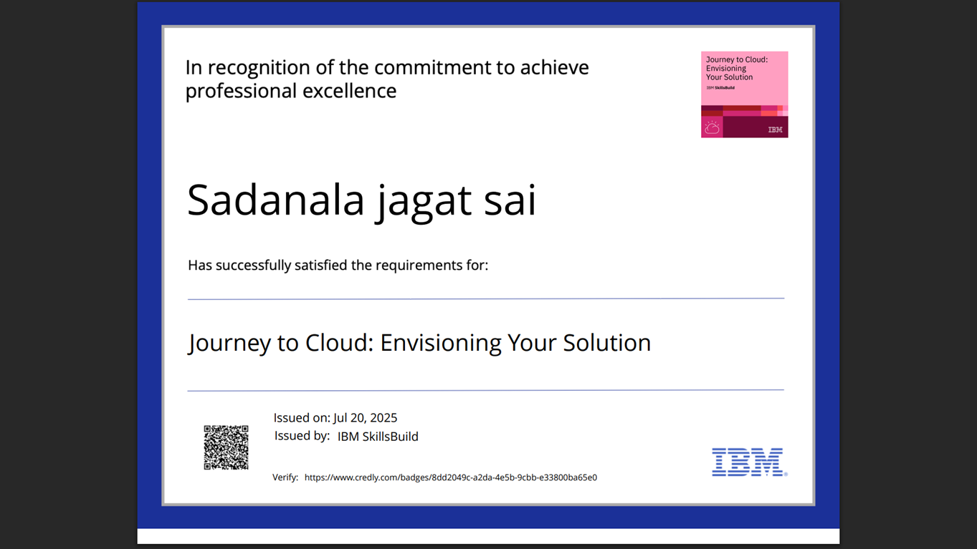
IBM Certifications

Slide 30
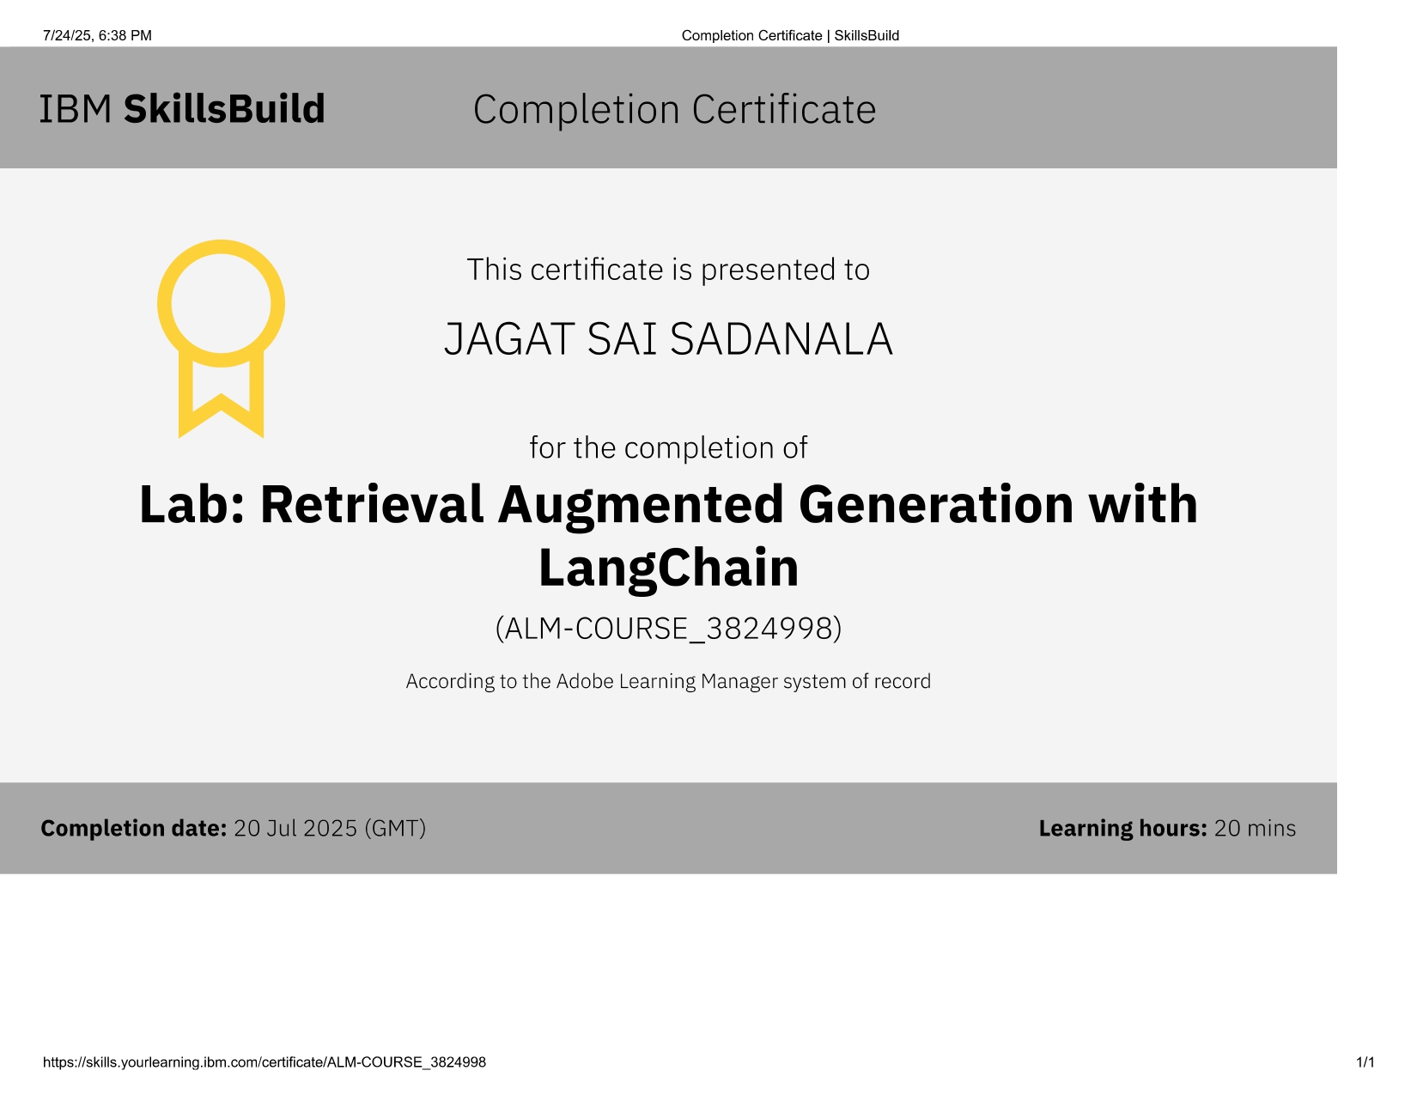
IBM Certifications

Slide 31
THANK YOU

